Slide 1
Student Attachment Management System

Slide 2
Objectives
Manage student attachment records.
Store organization and placement details.
Track attachment dates, status, and progress.
Perform CRUD operations on student records.
Provide a dashboard for easy monitoring.

Slide 3
Technology used
Python — application development
🗄️ SQLite — database storage
💻 SQL — managing and retrieving data
📝 VS Code — writing and running the code
📊 Matplotlib — creating charts for the dashboard

Slide 4
System features
Create — add new student and attachment records.
Read — view student, organization, and attachment details.
Update — modify student information.
Delete — remove student records.
Dashboard — view attachment status using charts.

Slide 5
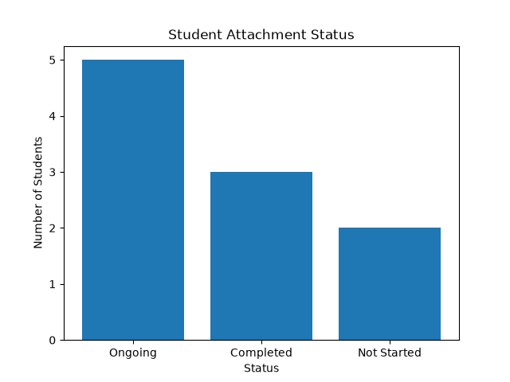
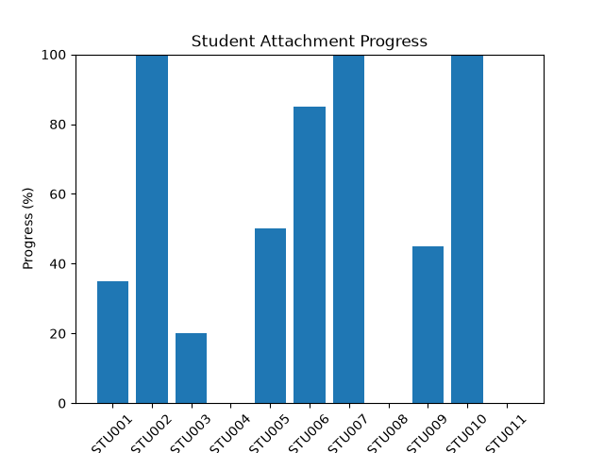
Dashboard and Data visualization

Slide 6
Conclusion
The Student Attachment Management System provides an organized way to manage student attachment records.
It stores student, organization, and attachment information in a structured database.
CRUD operations make it easier to add, view, update, and delete student records.
The dashboard helps users monitor attachment status and student progress through data visualization.

